Slide 1
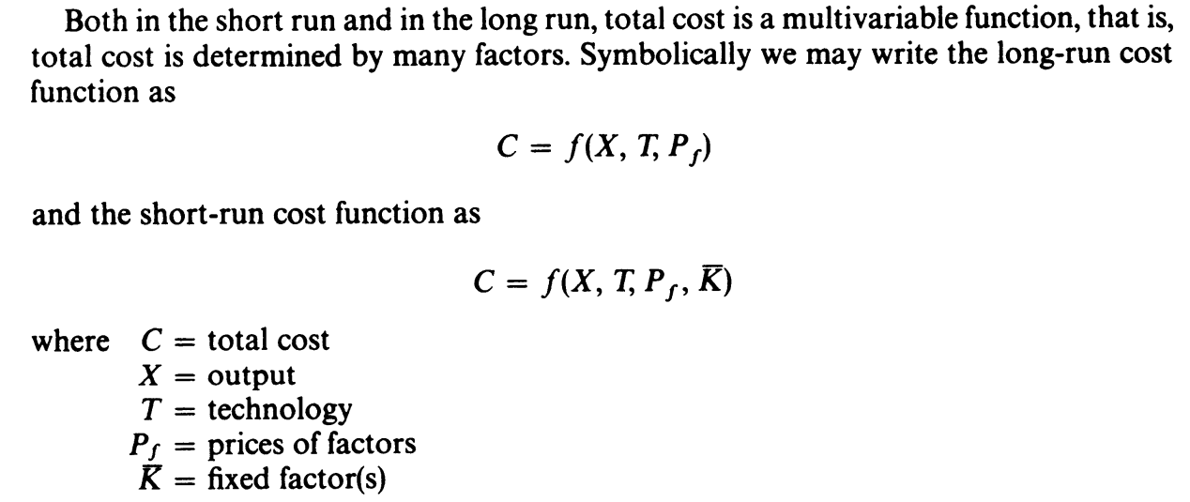

Slide 2

Traditional theory distinguishes between the short run and the long run.
The short run is the period during which some factor(s) is fixed; usually capital equipment and entrepreneurship are considered as fixed in the short run.
The long run is the period over which all factors become variable.

Slide 3
Accounting Costs and Economic Costs
The difference between accounting costs and economic costs requires further consideration.
The accounting costs are called explicit costs which include wages to hire labour, prices of raw materials, fuel and semi-finished products purchased for use in production and rental price of capital equipment and buildings.
When an entrepreneur undertakes an act of production, he has to pay prices for the factors which he employs for production. He thus pays wages to the labourers employed, prices for the raw materials, fuel and power used, rent for the building he hires for the production work, and the rate of interest on the money borrowed for doing business.
All these are included in his cost of production. An accountant will take into account only the expenditure incurred on buying or hiring various inputs or factors for use in production.

Slide 4
The economists, therefore, also include in his costs of production the opportunity costs of the self-owned factors. Thus, in the calculation of costs the economists will include
(i) the normal return on money capital invested by the entrepreneur himself in his own business, which he could have earned if invested elsewhere. The normal return on his own capital invested by the entrepreneur in his own business is in fact the opportunity cost of his money capital
(ii) the wages or salary he could have earned if he sold his services to others as a manager or consultant. The accountants do not include these two items in the cost of production but the economists consider them as bonafide costs and will accordingly include them.

Slide 5
The accountants consider those costs which involve actual cash payments by the entrepreneur of the firm to others, the economists take into account all of these accounting costs.
But in addition, they also take into account the amount of money the entrepreneur could have earned if he had invested his money capital and sold his own services and other factors in the next best alternative uses.
The accounting costs or actual contractual cash payments that the firm makes to other factor owners for purchasing or hiring the various factors are also known as explicit costs.
Economic Costs = Accounting costs (i.e. explicit costs) + Implicit costs

Slide 6
Short and Long run Cost under the Traditional theory of Cost

Slide 7
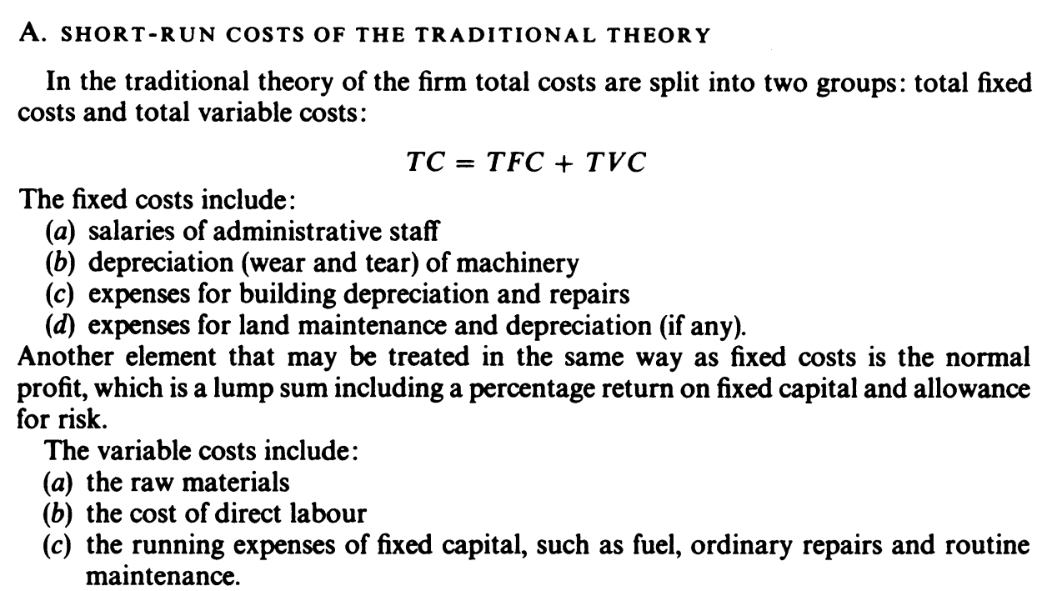

Slide 8
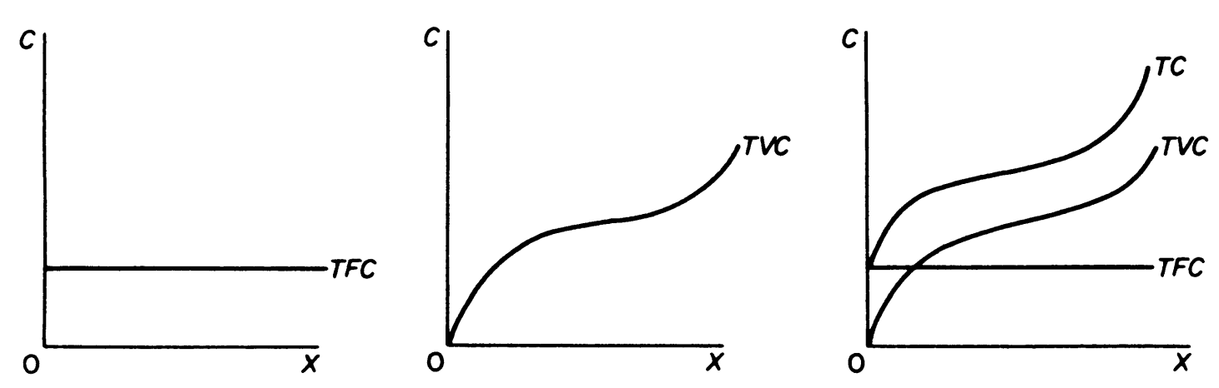

Slide 9
Quantity | TFC | TVC | TC | AFC | AVC | MC
0 | 20 | 0 | 20 | - | - | -
1 | 20 | 15 | 35 | 20 | 15 | 15
2 | 20 | 25 | 45 | 10 | 12.50 | 10
3 | 20 | 30 | 55 | 6.67 | 10 | 5
4 | 20 | 35 | 65 | 5 | 8.75 | 5
5 | 20 | 45 | 85 | 4 | 9 | 10
6 | 20 | 65 | 110 | 3.33 | 10.83 | 20

Slide 10
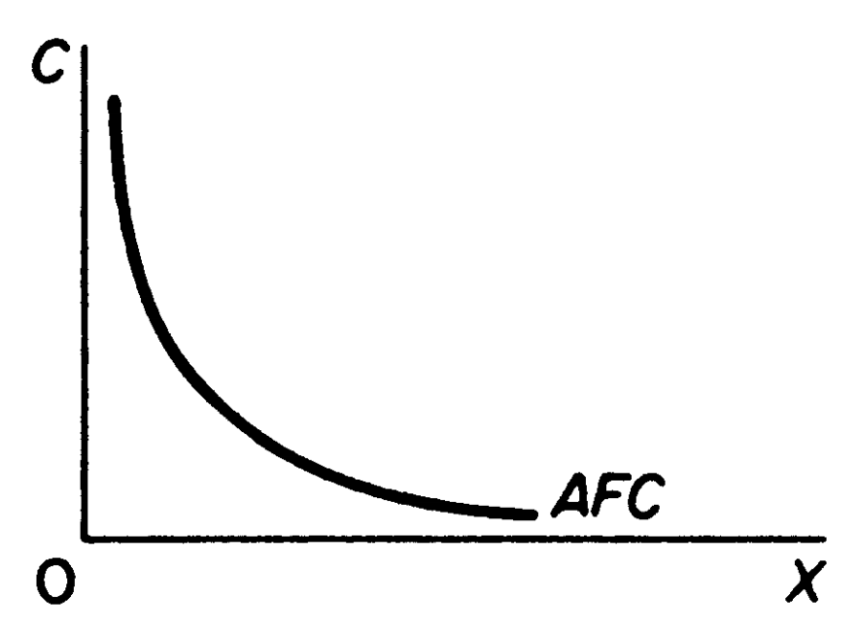

Slide 11
Fixed, Variable and Total Costs in the Short-Run

Slide 12
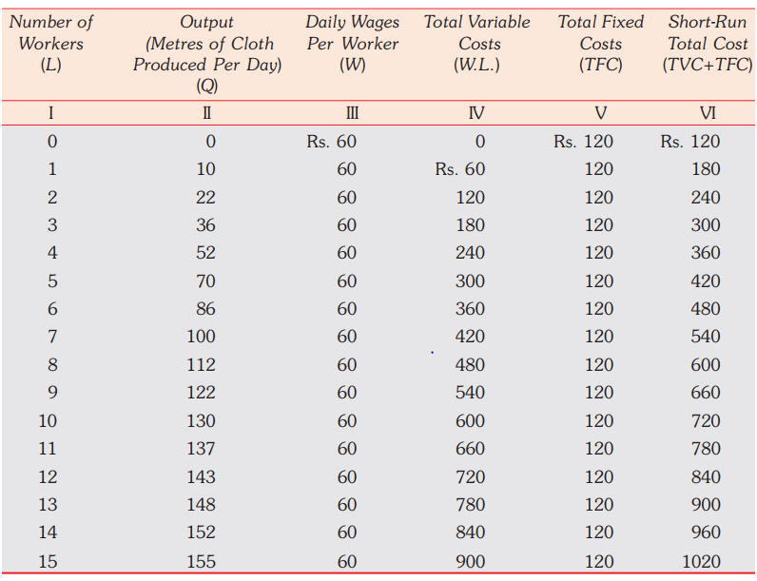

Slide 13
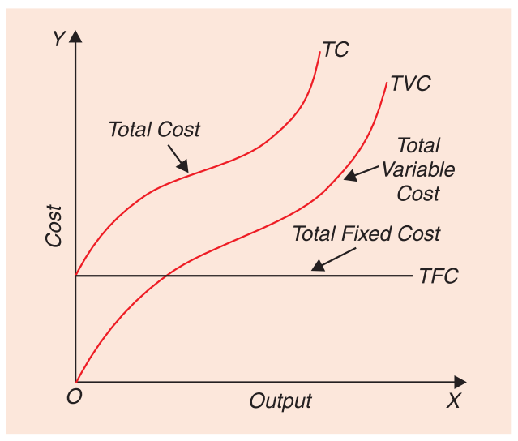

Slide 14
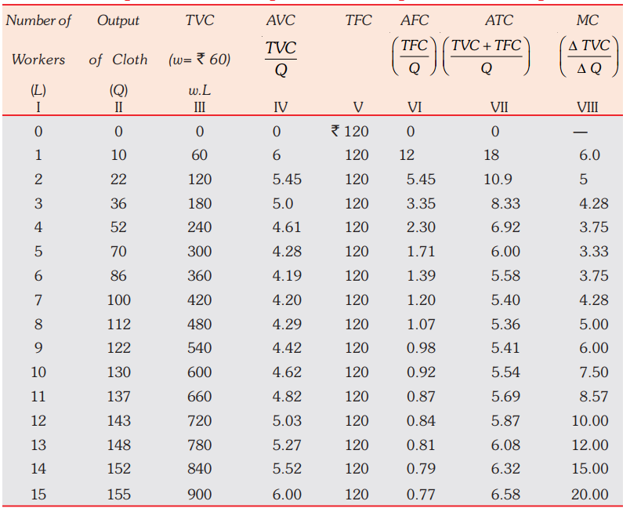

Slide 15
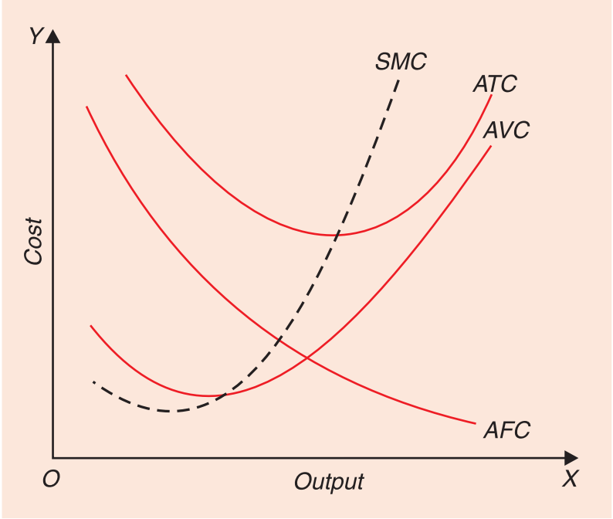

Slide 16
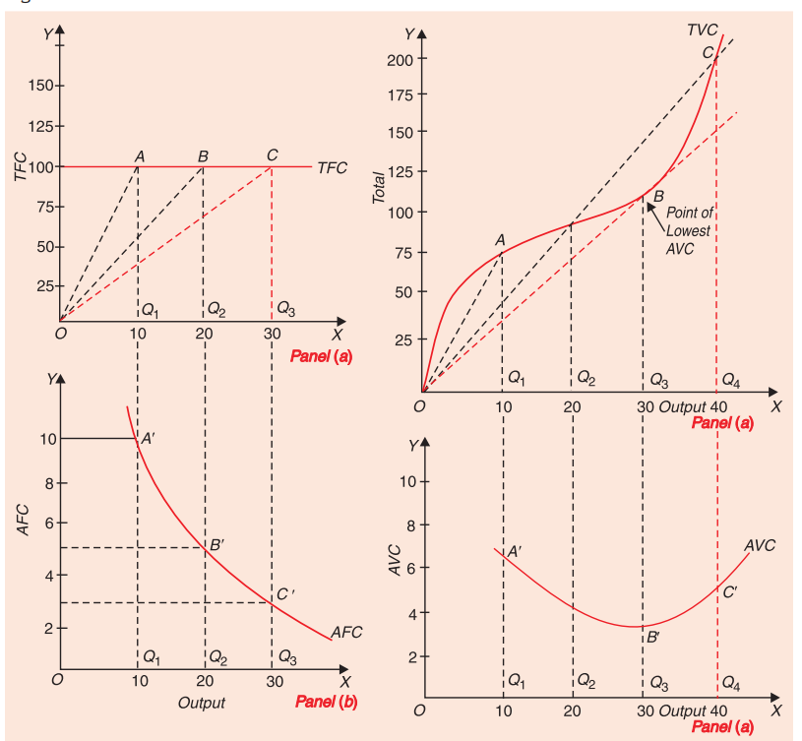

Slide 17
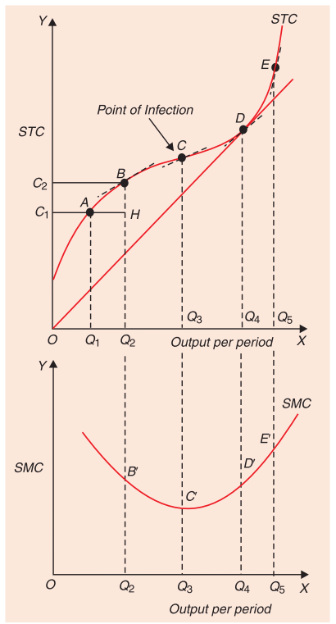

Slide 18
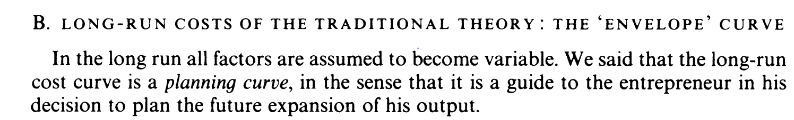

Slide 19
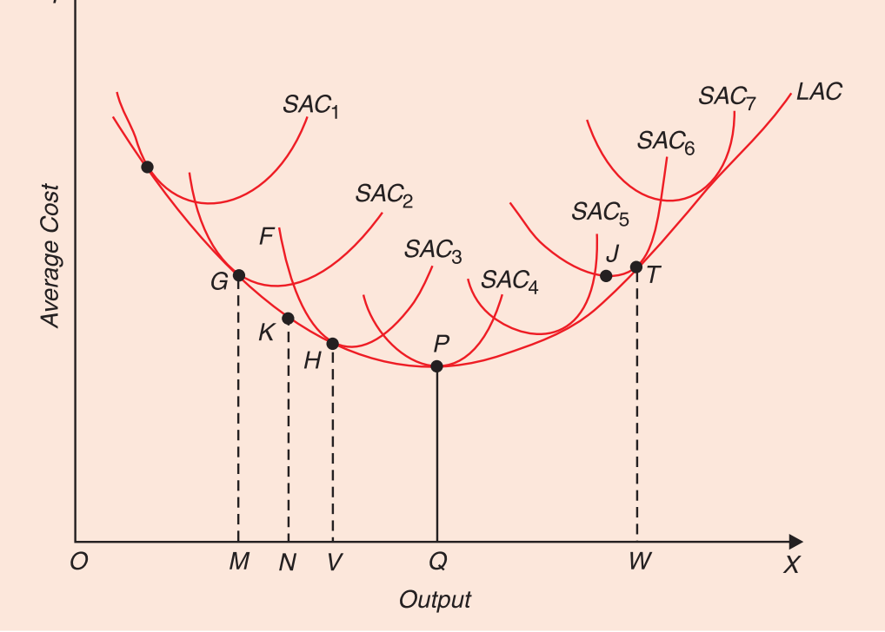

Slide 20
For producing output ON, the firm will build a plant which will correspond to that short-run average cost curve which is tangent to the long-run average cost curve LAC at point K corresponding to output ON. The long-run average cost curve LAC is also called ‘envelope’ since it envelops or supports a family of short-run average cost curves from below.
Long-run average cost curve is often called the ‘planning curve’ of the firm by some economists because a firm plans to produce any output in the long run by choosing a plant on the long-run average cost curve corresponding to the given output.
The long-run average cost curve reveals to the firm that how large should be the plant for producing a certain output at the least possible cost.

Slide 21
Long-Run Average Cost Curve in Case of Constant Returns to Scale
If the production function is linear and homogeneous (that is, homogeneous of the first degree) and also the prices of inputs remain constant, then the long-run average cost will remain constant at all levels of output.
Some economists like Kaldor, Joan Robinson, Stigler are of the view that when all factors of production are “perfectly divisible” then there would be no internal economies of scale (and no internal diseconomies). Therefore, according to them, in case of ‘perfect divisibility’ of all factors, the long-run average cost curve will be a horizontal straight line showing that the long-run average cost is constant whatever the level of output.

Slide 22
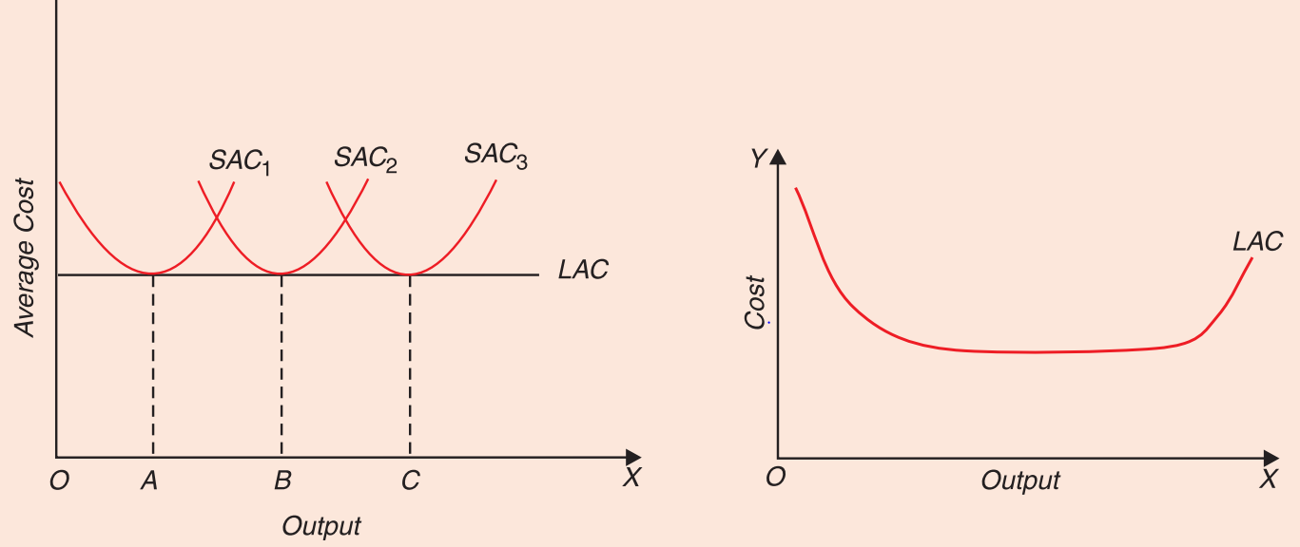

Slide 23
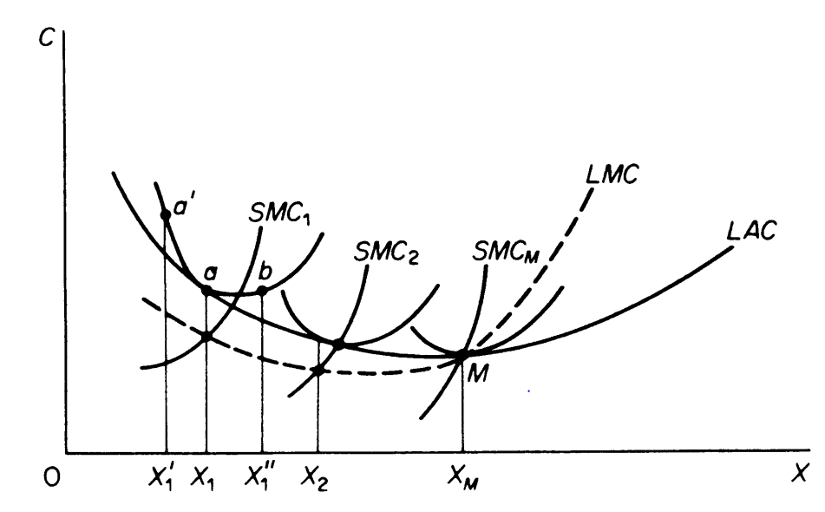

Slide 24
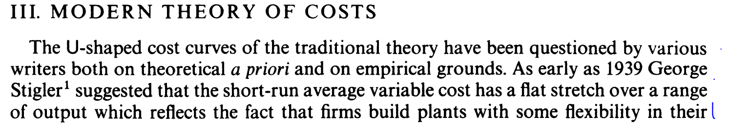

Slide 25
The shape of the long-run cost curve has attracted greater attention in economic literature, due probably to the serious policy implications of the economies of large-scale production. Several reasons have been put forward to explain why the long-run cost curve is L-shaped rather than U-shaped.
It has been argued that managerial diseconomies can be avoided by the improved methods of modern management science
Even when it appear (at very large scales of output) they are insignificant relative to the technical (production) economies of large plants, Thus total costs per unit of output fall, at least over the scales which have been operated in the real industrial world.

Slide 26
Typical load factor of each plant is two-thirds of its full capacity (limit capacity).
If we assume that there is a very large number of available plant sizes the LAC curve will be continuous

Slide 27
The average variable cost As in the traditional theory, the average variable cost of modern microeconomics includes the cost of: (a) direct labour which varies with the output (b) raw materials (c) running expenses of machinery. The SA VC in modern theory has a saucer-type shape, that is, it is broadly U-shaped but has a flat stretch over a range of output.
The flat stretch corresponds to built-in-the-plant reserve capacity. Over this stretch the SA VC is equal to MC, both being constant per unit of output. To the left of the flat stretch, MC lies below SAVC, while to the right of the flat stretch the MC rises above the SA VC.
The falling part of the SA VC shows the reduction in costs due to the better utilisation of the fixed factor and the consequent increase in skills and productivity of the variable factor (labour). With better skills the wastes in raw materials are also being reduced and a better utilisation of the whole plant is reached.

Slide 28
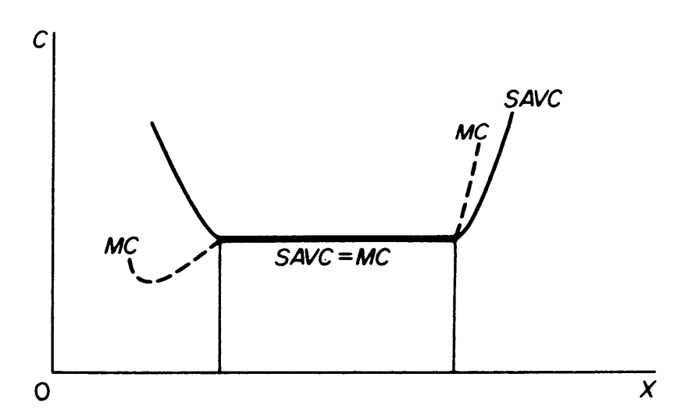

Slide 29
The innovation of modern microeconomics in this field is the theoretical establishment of a short-run SA V C curve with a flat stretch over a certain range of output.
The reserve capacity makes it possible to have constant SA VC within a certain range of output.
It should be clear that this reserve capacity is planned in order to give the maximum flexibility in the operation of the firm. It is completely different from the excess capacity which arises with the U-shaped costs of the traditional theory of the firm.
The traditional theory assumes that each plant is designed without any flexibility; it is designed to produce optimally only a single level of output.
If the firm produces an output X smaller than X M there is excess (unplanned),equal to the difference X M - X.

Slide 30
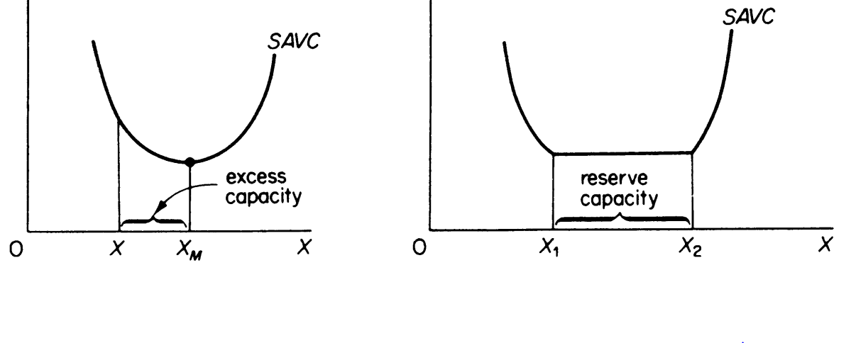

Slide 31
LONG-RUN COSTS IN MODERN MICROECONOMIC THEORY: THE 'L-SHAPED' SCALE CURVE
These are distinguished into production costs and managerial costs. All costs are variable in the long run and they give rise to a long-run cost curve which is roughly L-shaped.
The production costs fall continuously with increases in output. At very large scales of output managerial costs may rise. But the fall in production costs more than offsets the increase in the managerial costs, so that the total LAC falls with increases in scale.

Slide 32
Production costs:
Production costs fall steeply to begin with and then gradually as the scale of production increases. The L-shape of the production cost curve is explained by the technical economies of large-scale production.
Initially these economies are substantial, but after a certain level of output is reached all or most of these economies are attained and the firm is said to have reached the minimum optimal scale, given the technology of the industry.
If new techniques are invented for larger scales of output, they must be cheaper to operate. But even with the existing known techniques, some economies can always be achieved at larger outputs:
(a) economies from further decentralization and improvement in skills; (b) lower repairs costs may be attained if the firm reaches a certain size; (c) the firm possess multiproduct, may well undertake itself the production of some of the materials or equipment which it needs instead of buying them from other firms.

Slide 33
Managerial cost
In the modern management science for each plant size there is a corresponding organizational-administrative set-up appropriate for the smooth operation of that plant.
There are various levels of management, each with its appropriate kind of management technique. Each management technique is applicable to a range of outputs. There are small-scale as well as large-scale organisational techniques.
The costs of different techniques of management first fall up to a certain plant size. At very large scales of output managerial costs may rise, but very slowly.
In summary: Production costs fall smoothly at very large scales, while managerial costs may rise only slowly at very large scales. Modern theorists seem to accept that the fall in technical costs more than offsets the probable rise of managerial costs, so that the LRAC curve falls smoothly or remains constant at very large scales of output.

Slide 34
THE LEARNING CURVE
The learning curve is an important modern concept according to which cumulative experience by a firm in the production of a product over time increases efficiency in the use of inputs such as labor and raw materials and thereby lowers cost per unit of output.
Arrow, one of the pioneers in putting forward this concept calls it “Learning by Doing” .
According to Arrow, as a firm or its manager produces successive lots of output over various periods of time, it learns to produce more with a given quantity of resources or it is capable of producing a given output by using lesser quantities of inputs or resources than before.
Either, with the increase in efficiency of resources or with saving in resources such as labour and raw materials, cost per unit of output declines as a firm gathers more experience over time. This learning curve effect mostly occurs in the reduction of labour requirements per unit of output.

Slide 35
As the cumulative volume of output over successive periods of time increases, labor and supervisors become more familiar with the work methods or the production process, which leads to a reduction in the amount of scrap and other types of waste.
Besides, raw materials cost per unit of output may also decline as the cumulative volume of output in successive periods over time increases and as a result a firm gains more experience in doing a production process repeatedly over successive time periods.

Slide 36
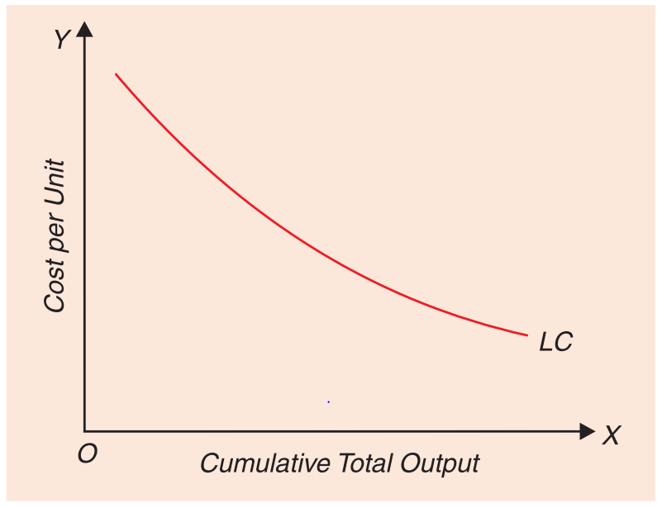
The learning curve is graphically shown in Fig below, where on the X-axis cumulative total output over successive periods of time and on the Y-axis cost per unit of output are measured. It will be seen from Fig that the learning curve slopes downward which shows declining cost per unit of output as cumulative output increases over time and the firm learns from its work experience.

Slide 37
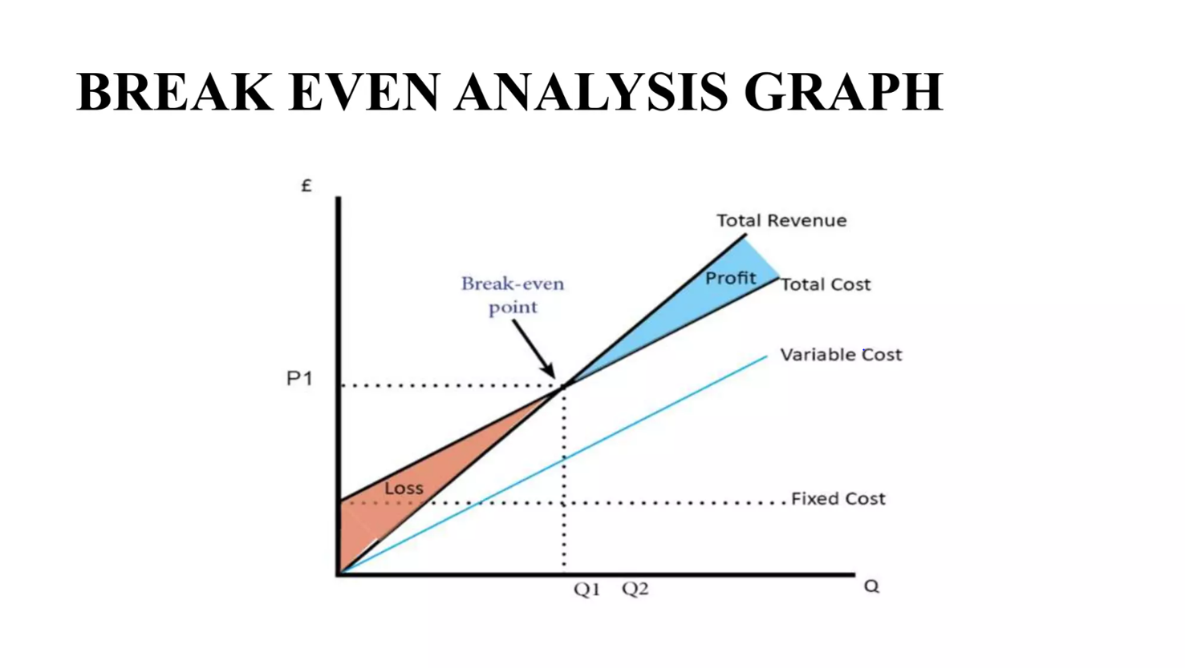

Slide 38
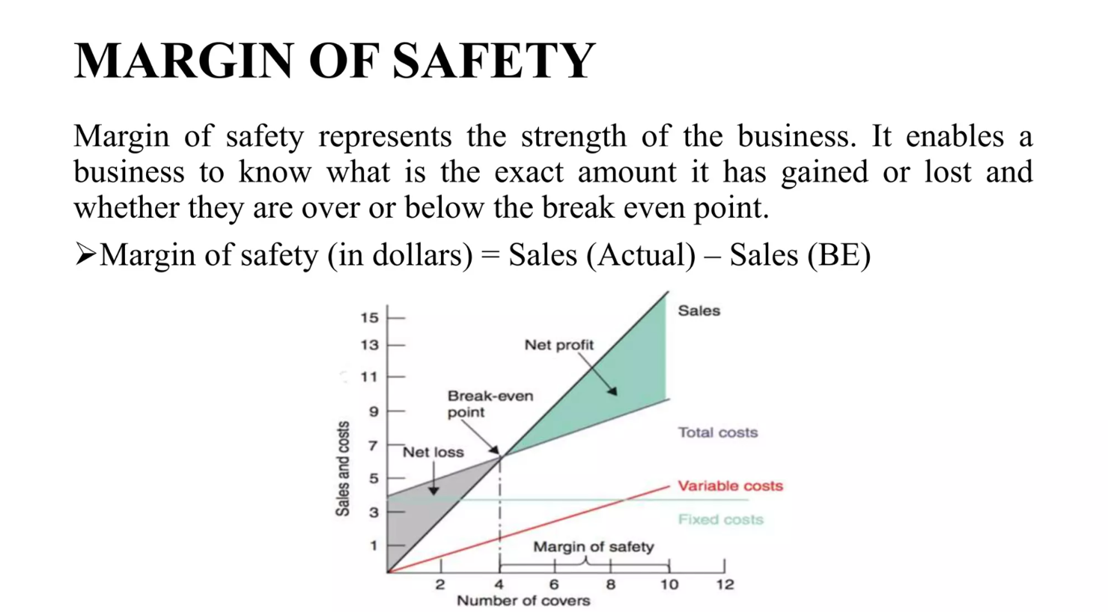

Slide 39
Uses of Break-Even Analysis
New business: For a new venture, a break-even analysis is essential. It guides the management with pricing strategy and is practical about the cost. This analysis also gives an idea if the new business is productive.
Manufacture new products: If an existing company is going to launch a new product, then they still have to focus on a break-even analysis before starting and see if the product adds necessary expenditure to the company.
Change in business model: The break-even analysis works even if there is a change in any business model like shifting from retail business to wholesale business. This analysis will help the company to determine if the selling price of a product needs to change.
Break-Even Analysis Formula
Break-even point = Fixed cost/-Price per cost – Variable cost

Slide 40
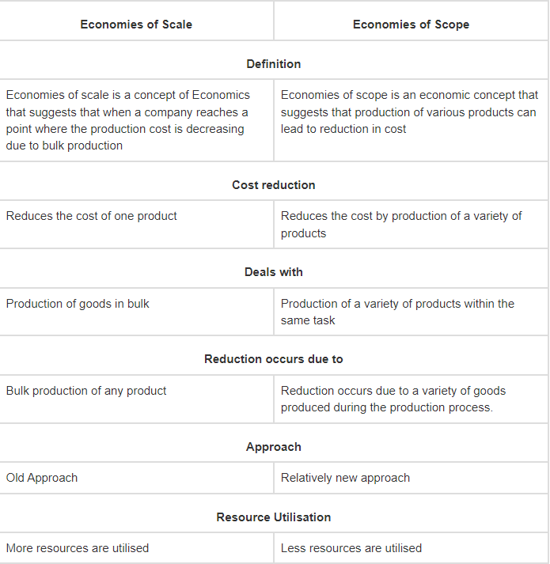

Slide 41
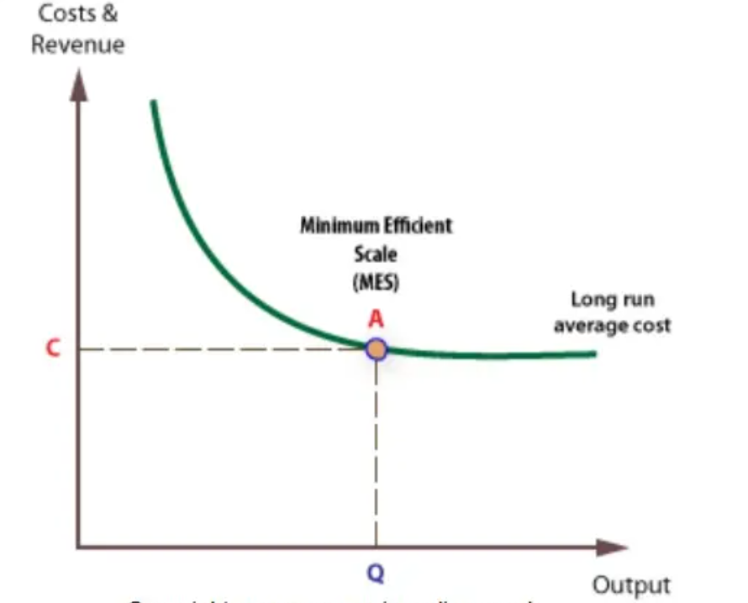

Slide 42
When minimum efficient scale is low, relative to the size of the whole industry, a large number of firms can operate efficiently, as in the case of most retail businesses, like corner shops and restaurants.
However, if minimum efficient scale can only be achieved at very high levels of output relative to the whole industry, the number of firms in the industry will be small. This is the case with natural monopolies, such as water, gas, and electricity supply.

